Slide 1
Discrete-Time Signals and Systems
Lecture 25

Slide 2
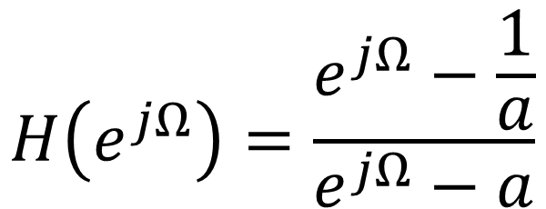
Which kind of filter is this system ?
$$H\left(e^{jΩ}\right)=\frac{e^{jΩ}−\frac{1}{a}}{e^{jΩ}−a}$$
×
1) Low pass filter | 2) High pass filter
3) All pass filter | 4) Band pass filter

Slide 3
Which kind of filter is this system ?
$$H\left(e^{jΩ}\right)=\frac{e^{jΩ}−\frac{1}{a}}{e^{jΩ}−a}$$
×
1) Low pass filter | 2) High pass filter
3) All pass filter | 4) Band pass filter

Slide 4
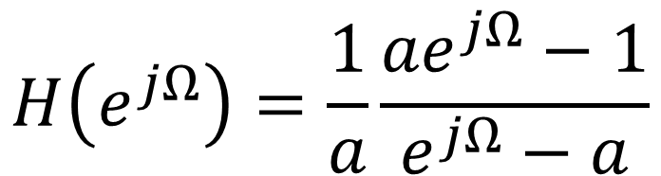
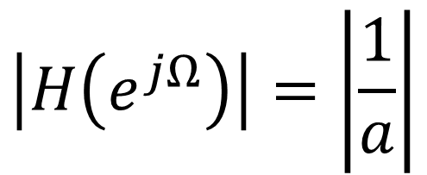
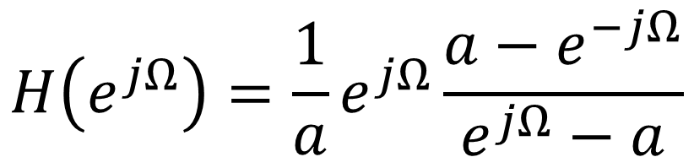
What kind of filter is this?
$$H\left(e^{jΩ}\right)=\frac{e^{jΩ}−\frac{1}{a}}{e^{jΩ}−a}$$
$$H\left(e^{jΩ}\right)=\frac{1}{a}\frac{{ae}^{jΩ}−1}{e^{jΩ}−a}$$
$$\left|H\left(e^{jΩ}\right)\right|=\left|\frac{1}{a}\right|$$
$$H\left(e^{jΩ}\right)=\frac{1}{a}e^{jΩ}\frac{a−e^{−jΩ}}{e^{jΩ}−a}$$

Slide 5











Effect of all-pass filter
$$\left|H(e^{jΩ)}\right|$$
$$x[n]$$
$$H\left(z\right)=\frac{1−az}{z−a}$$
$$y[n]$$
$$Ω$$
$$2π$$
$$z−plane$$
$$∠H(e^{jΩ)}$$
$$π$$
$$Ω$$
$$2π$$

Slide 6
How does applications react to amplitude and phase distortions?
All pass filters
x(t)
y(t)

Slide 7
Effect of phase change on Music and Speech
Music (without phase distortions)
Music (with phase distortions)
Speech (‘bat’ without phase distortions)
Speech (‘bat’ with phase distortions)

Slide 8

Effect of phase change on Music and Speech
Music (without phase distortions)
Music (with phase distortions)
Speech (‘bat’ without phase distortions)
Speech (‘bat’ with phase distortions)

Slide 9
Effect of phase change on Music and Speech
Music (without phase distortions)
Music (with phase distortions)
Speech (‘bat’ without phase distortions)
Speech (‘bat’ with phase distortions)

Slide 10
Effect of phase change on Music and Speech
Music (without phase distortions)
Music (with phase distortions)
Speech (‘bat’ without phase distortions)
Speech (‘bat’ with phase distortions)

Slide 11
Effect of phase change on Music and Speech
Music (without phase distortions)
Music (with phase distortions)
Speech (‘bat’ without phase distortions)
Speech (‘bat’ with phase distortions)

Slide 12
Effect of phase change on Music and Speech
Music (without phase distortions)
Music (with phase distortions)
Speech (‘bat’ without phase distortions)
Speech (‘bat’ with phase distortions)
Ohm’s law: We hear only amplitude and frequency of sound waves

Slide 13
Effect of phase change on Music and Speech
Complicated Speech (without phase distortions)
Complicated Speech (with phase distortions)
Hello Class! Abhishek Dixit is an awesome teacher!

Slide 14
Effect of phase change on Music and Speech
Complicated Speech (without phase distortions)
Complicated Speech (with phase distortions)
Hello Class! Abhishek Dixit is an awesome teacher!

Slide 15
Effect of phase change on Music and Speech
Complicated Speech (without phase distortions)
Complicated Speech (with phase distortions)
Hello Class! Abhishek Dixit is an awesome teacher!

Slide 16
Effect of phase reversal on Music and Speech
Complicated Speech (without phase distortions)
Complicated Speech (with phase distortions)
Complicated Speech (with phase reversal)
Hello Class! Abhishek Dixit is an awesome teacher!

Slide 17
Effect of phase reversal on Music and Speech
Complicated Speech (without phase distortions)
Complicated Speech (with phase distortions)
Complicated Speech (with phase reversal)
Hello Class! Abhishek Dixit is an awesome teacher!

Slide 18
Effect of phase change on Music and Speech
Music reversal

Slide 19
Effect of phase change on Music and Speech
Music reversal

Slide 20
Effect of phase change on Music and Speech
Music reversal
How are the phase of two signals related?
Phase gets flipped in sign

Slide 21
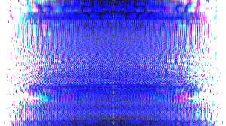


Effect of phase change on pictures

Slide 22
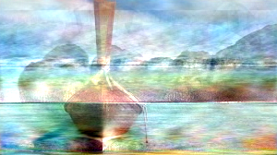

Effect of phase change on pictures
Amplitude profile is substituted from another picture
Phase profile is randomized

Slide 23

Effect of phase change on pictures

Slide 24
Complex conjugate

Slide 25
Prove
is real
is even
is odd

Slide 26
Input & Output
LTI
?
LTI

Slide 27
Discrete-time Fourier Transform

Slide 28
Deriving h[n]

Slide 29
Deriving h[n]

Slide 30
Deriving h[n]

Slide 31
Discrete-time Fourier Transform

Slide 32
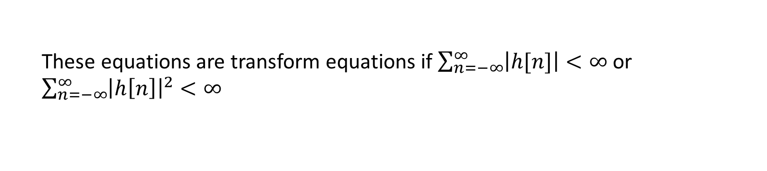
Discrete-time Fourier Transform
These equations are transform equations if $\sum_{n=−∞}^{∞}{\left|h[n]\right|<∞}$ or $\sum_{n=−∞}^{∞}{{\left|h\left[n\right]\right|}^{2}<∞}$
No Gibbs phenomenon here

Slide 33
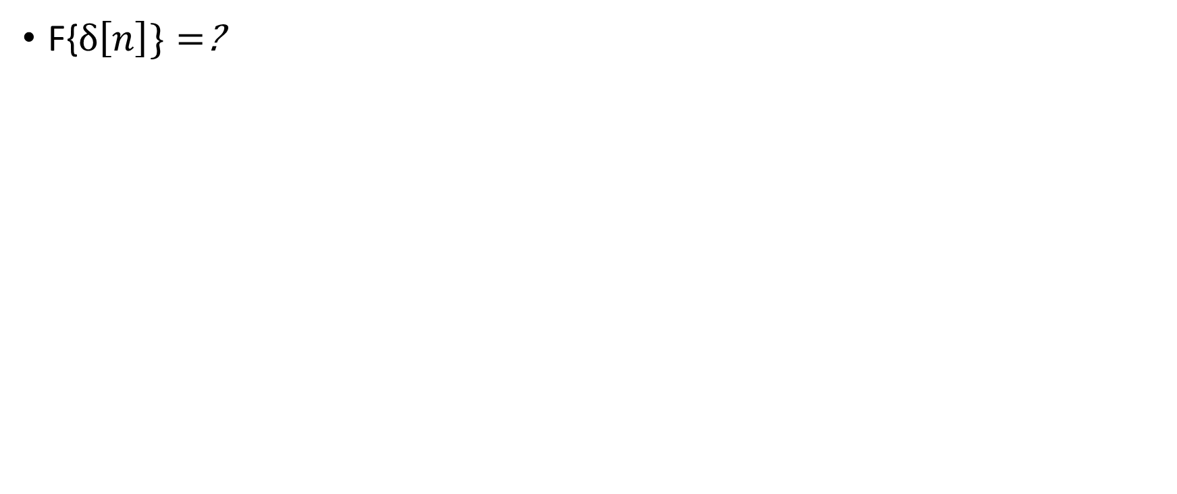
Examples of FT pairs
F{$δ\left[n\right]\}=$?

Slide 34
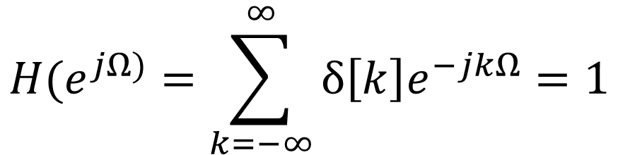
Examples of FT pairs
F{$δ\left[n\right]\}=$?
$$H(e^{jΩ)}=\sum_{k=−∞}^{∞}{δ\left[k\right]e^{−jkΩ}=1}$$

Slide 35
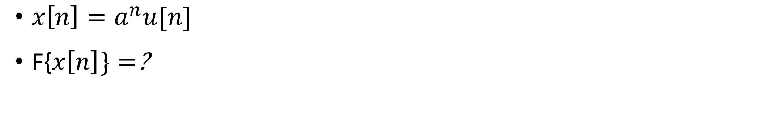
Examples of FT pairs
$x\left[n\right]=a^{n}u[n]$
F{$x\left[n\right]\}=$?

Slide 36
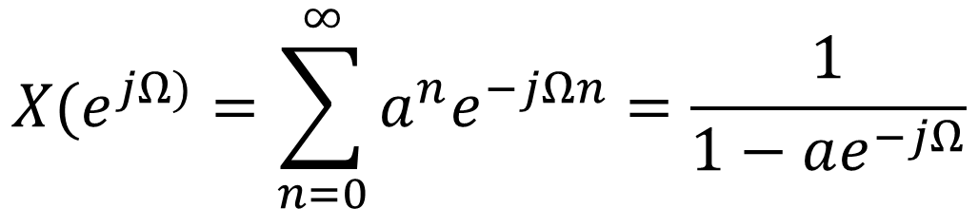
Examples of FT pairs
$x\left[n\right]=a^{n}u[n]$
F{$x\left[n\right]\}=$?
$$X(e^{jΩ)}=\sum_{n=0}^{∞}{{a^{n}e}^{−jΩn}=\frac{1}{1−ae^{−jΩ}}}$$

Slide 37
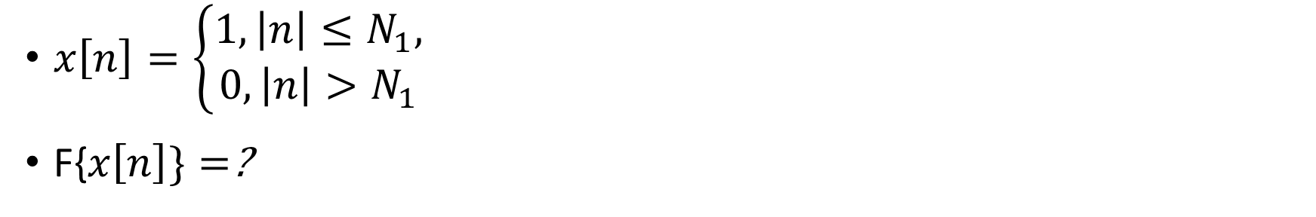
Examples of FT pairs
$x\left[n\right]=\left\{\begin{aligned}1, \left|n\right|≤N_{1}, \\ 0, \left|n\right|>N_{1}\end{aligned}\right.$
F{$x\left[n\right]\}=$?

Slide 38
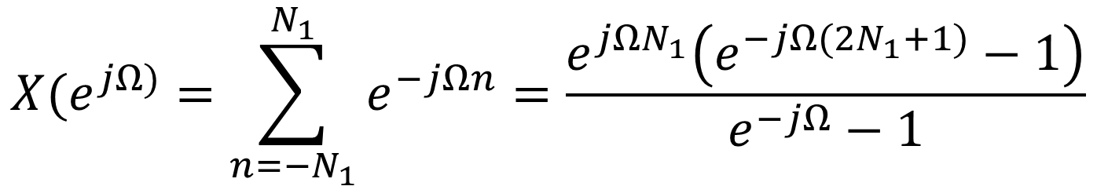
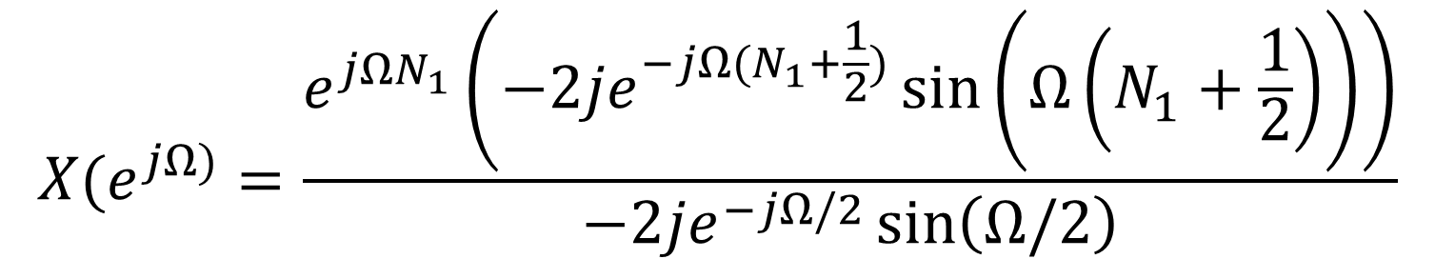
Examples of FT pairs
$x\left[n\right]=\left\{\begin{aligned}1, \left|n\right|≤N_{1}, \\ 0, \left|n\right|>N_{1}\end{aligned}\right.$
F{$x\left[n\right]\}=$?
$$X(e^{jΩ)}=\sum_{n=−N_{1}}^{N_{1}}{e^{−jΩn}=\frac{e^{jΩN_{1}}\left(e^{−jΩ(2N_{1}+1)}−1\right)}{e^{−jΩ}−1}}$$
$$X(e^{jΩ)}=\frac{e^{jΩN_{1}}\left({−2je}^{−jΩ(N_{1}+\frac{1}{2})}\sin\left(Ω\left(N_{1}+\frac{1}{2}\right)\right)\right)}{−2je^{−jΩ/2}\sin\left(Ω/2\right)}$$

Slide 39
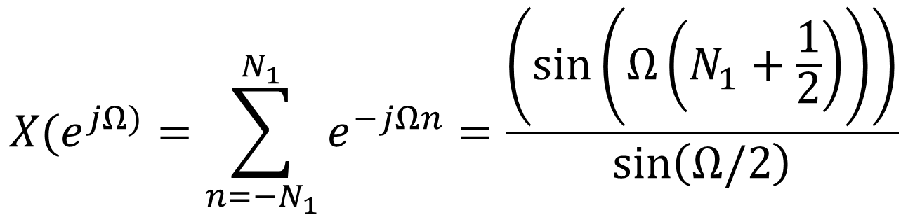
Examples of FT pairs
$x\left[n\right]=\left\{\begin{aligned}1, \left|n\right|≤N_{1}, \\ 0, \left|n\right|>N_{1}\end{aligned}\right.$
F{$x\left[n\right]\}=$?
$$X(e^{jΩ)}=\sum_{n=−N_{1}}^{N_{1}}{e^{−jΩn}=\frac{\left(\sin\left(Ω\left(N_{1}+\frac{1}{2}\right)\right)\right)}{\sin\left(Ω/2\right)}}$$

Slide 40
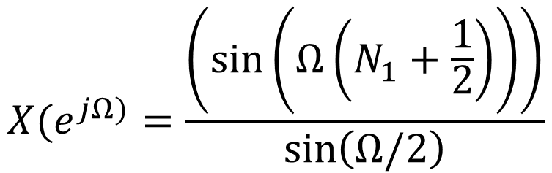
Examples of FT pairs
$$X(e^{jΩ)}=\frac{\left(\sin\left(Ω\left(N_{1}+\frac{1}{2}\right)\right)\right)}{\sin\left(Ω/2\right)}$$

Slide 41
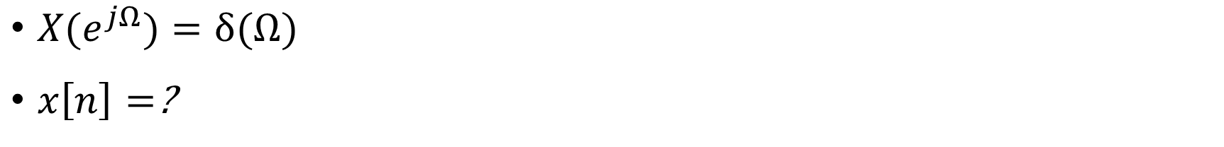
Examples of FT pairs
$X(e^{jΩ})=δ(Ω)$
$x\left[n\right]=$?

Slide 42
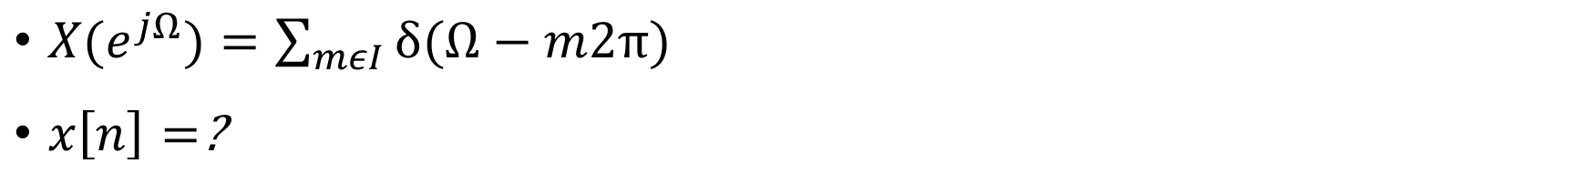
Examples of FT pairs
$X(e^{jΩ})=\sum_{mεI}{δ(Ω−m2π) }$
$x\left[n\right]=$?

Slide 43
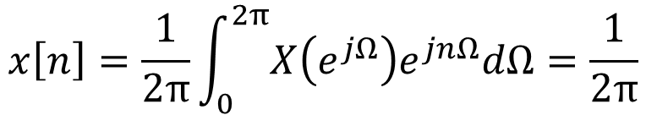
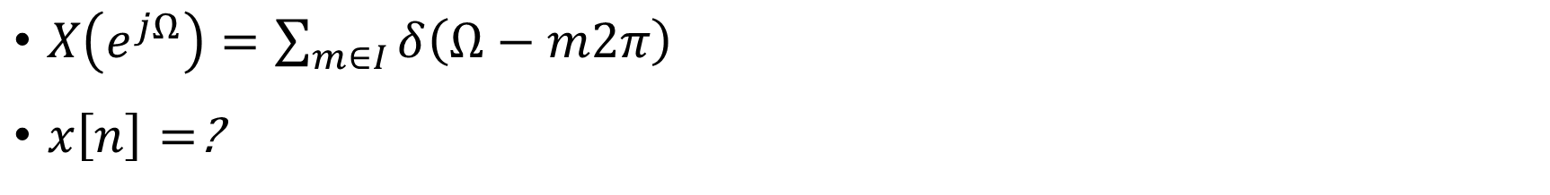
Examples of FT pairs
$X\left(e^{jΩ}\right)=\sum_{m∈I}{δ\left(Ω−m2π\right) }$
$x\left[n\right]=$?
$$x\left[n\right]=\frac{1}{2π}\int_{0}^{2π}{X\left(e^{jΩ}\right)e^{jnΩ}dΩ}=\frac{1}{2π}$$

Slide 44
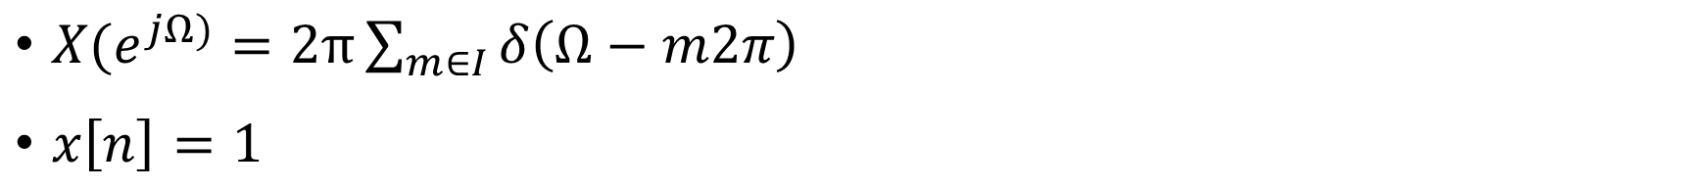
Examples of FT pairs
$X(e^{jΩ)}=2π\sum_{m∈I}{δ\left(Ω−m2π\right) }$
$x\left[n\right]=1$

